Slide 1
Unit 3A
Human Form & Function
Cells, metabolism & regulation
Regulation of gas concentrations

Slide 2
Learning Objective
The homeostatic mechanisms that control the physiological & behavioural mechanisms that influence the regulation of gas concentrations.

Slide 3
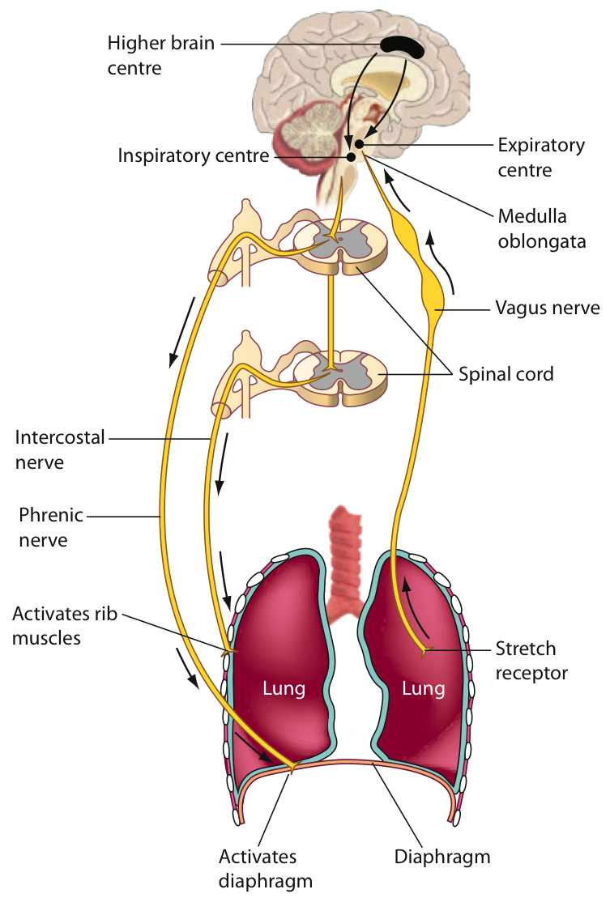
Control of breathing & respiratory centres in in the brain
Changes in breathing alter the amount of oxygen taken in and the amount of carbon dioxide excreted.

Slide 4
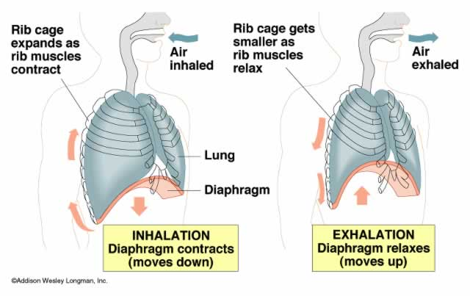
Recall Mechanics of breathing: Inhalation & exhalation

Slide 5
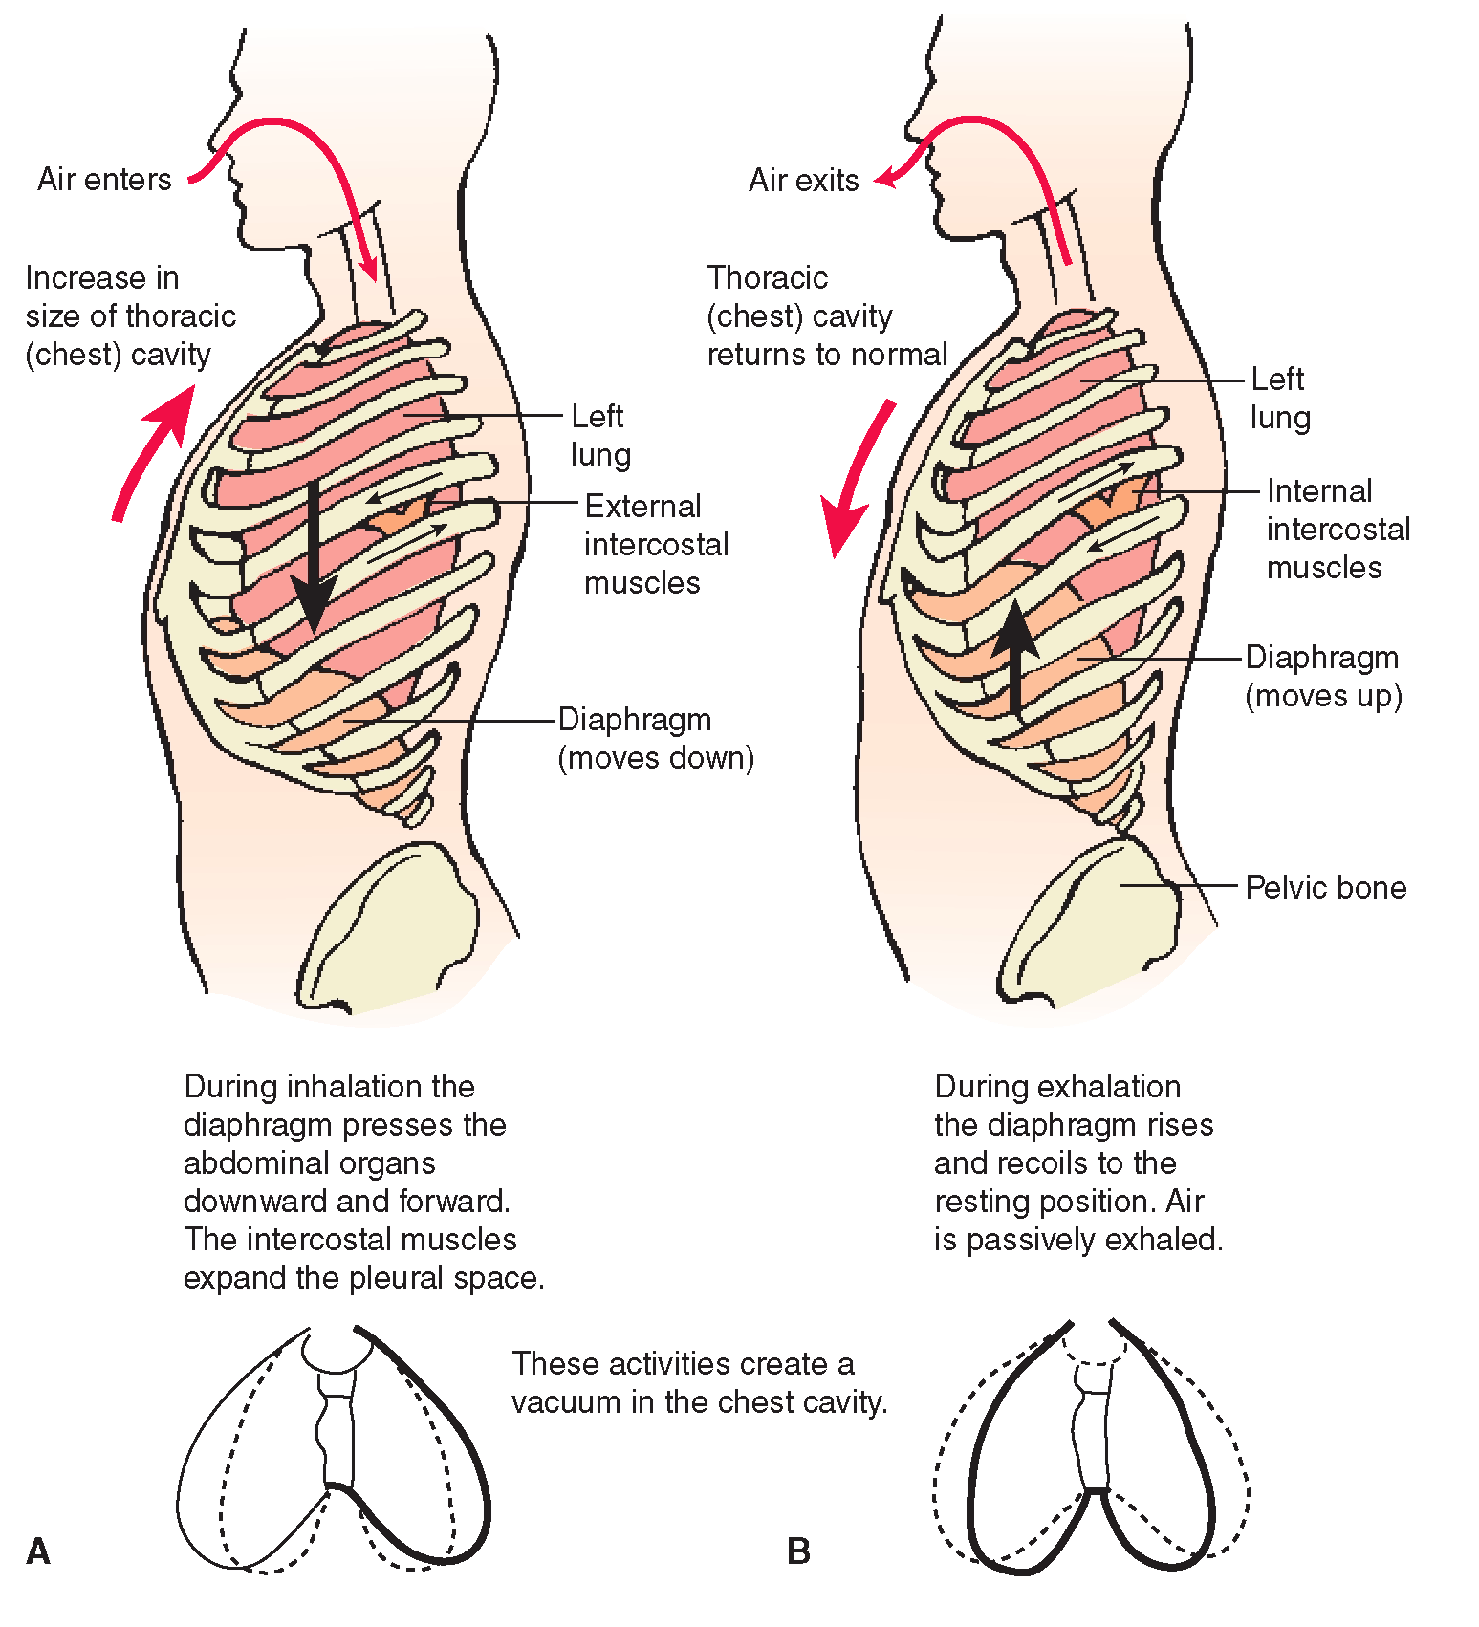

Slide 6
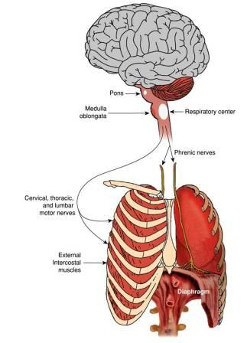
Control of breathing: The Diaphragm:
A muscle that causes air to move in & out of the lungs.
It is stimulated by impulses from the phrenic nerve, while impulses from the intercostal nerves stimulate the intercostal muscles

Slide 7
Respiratory minute volume (RMV)
The respiratory minute volume is the amount of air you move in or out of your lungs each minute.
The RMV is affected by the tidal volume (the amount of air you move in or out of your lungs in a single respiratory cycle) and the breathing rate (the number of breaths you take each minute).
RMV = Breathing rate x Tidal volume

Slide 8
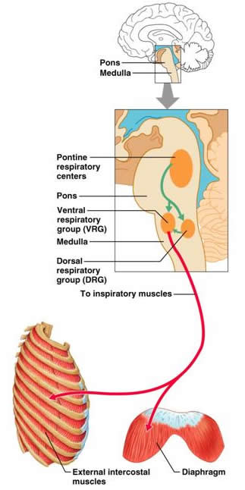
Control of breathing: Respiratory centre
Located in the Medulla Oblongata (Brain stem)
Control nerve impulses that control the diaphragm & intercostal muscles.

Slide 9
Control of breathing
Breathing can be voluntary or involuntary.
Control centres occur in the medulla oblongata:
  Medullary rhythmicity centre (normal breathing)
  Apneustic centre – rate of breathing
  Pneumotaxic centre – depth of breathing
Nerve impulses activate respiratory muscles:
  Diaphragm
  Intercostal muscles (internal & external)

Slide 10
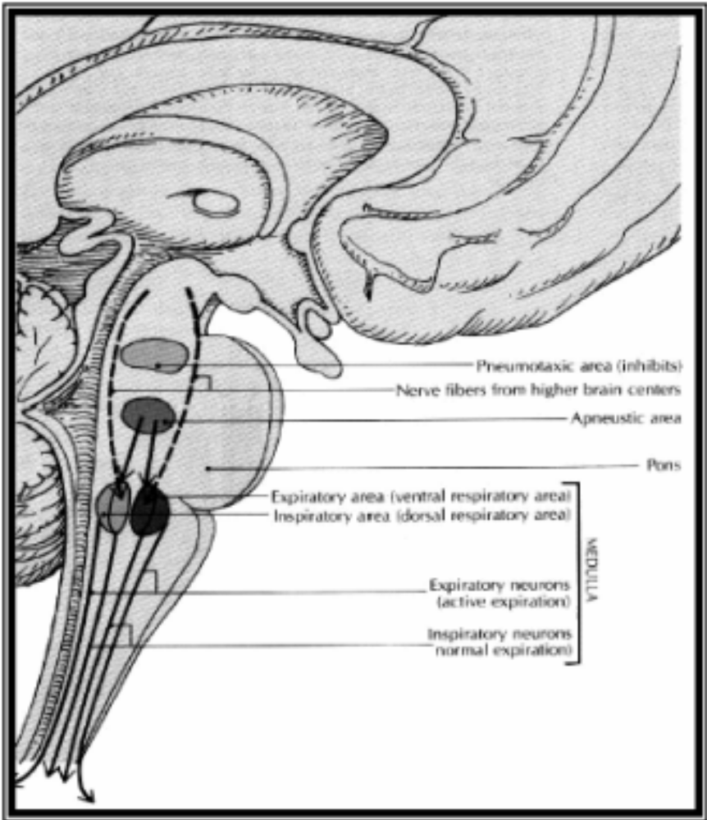

Slide 11
Normal breathing patterns
Respiratory cycle
Quiet breathing
Inhalation – active
Exhalation - passive
Forced breathing
Inhalation & exhalation active
Diaphragmatic
(deep) breathing
Costal
(shallow) breathing

Slide 12
Regulation of the normal breathing cycle
Quiet breathing
Inspiration
  Inspiratory nucleus activated
  Nerve impulses sent to respiratory muscles
  Respiratory muscles contract
  (2 seconds)
Expiration
  Inspiratory nucleus suppressed
  Respiratory muscles relax
  (3 seconds)

Slide 13
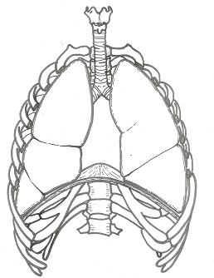
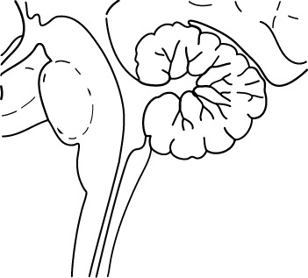
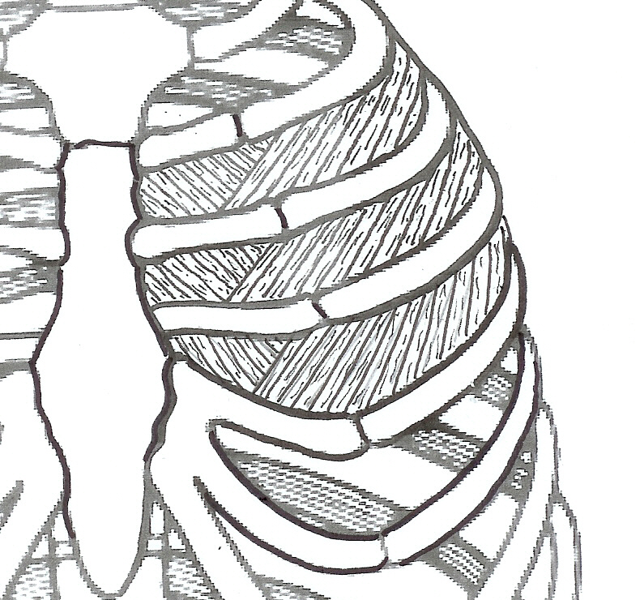
Control of normal breathing
Impulse to diaphragm & external intercostal muscles
INHALE
+
-
Inspiratory nucleus
Exspiratory nucleus
EXHALE
Medullary rhythmicity centre
Impulse to internal intercostal muscles

Slide 14
Regulation of forced breathing
Forced breathing
Inspiration
  Inspiratory nucleus activated/ expiratory nucleus suppressed
  Nerve impulses sent to respiratory muscles
  Inspiratory muscles contract/expiratory muscles relax
Expiration
  Expiratory nucleus activated/Inspiratory nucleus suppressed
  Nerve impulses sent to respiratory muscles
  Expiratory muscles contract/Inspiratory muscles relax

Slide 15
Respiratory reflexes
Normal breathing is modified by:
Changes in levels of oxygen & carbon dioxide, both carried in blood, changes in concentration effect breathing rate
Changes in blood pressure
Stretch receptors in lungs
Irritants (sneezing, coughing etc.)
Sensations such as cold or pain

Slide 16
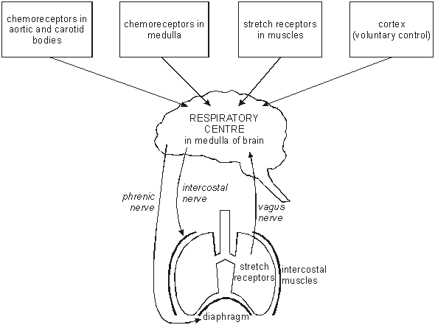
Respiratory centre.
It receives inputs from various receptors around the body and sends output through two nerves to the muscles around the lungs.

Slide 17
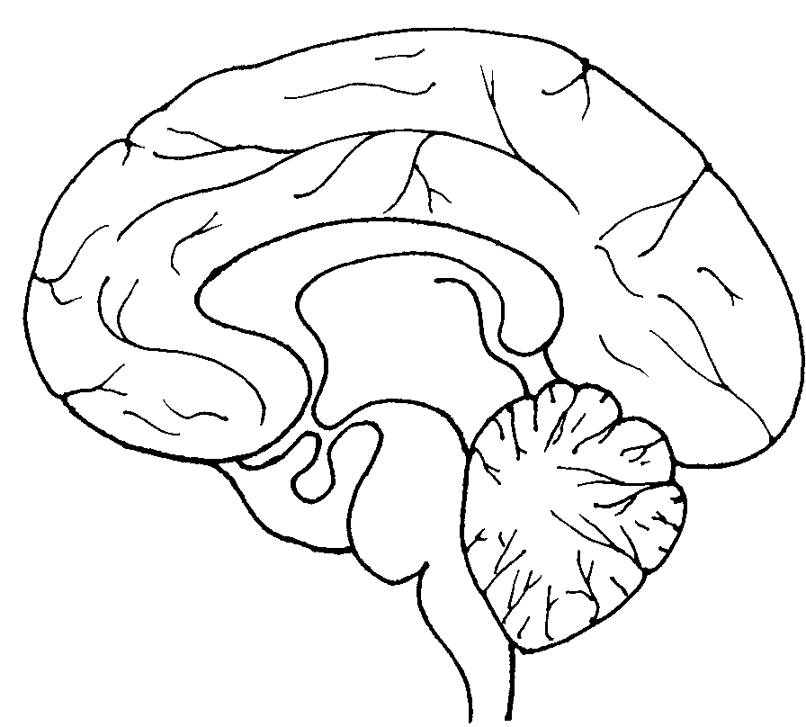
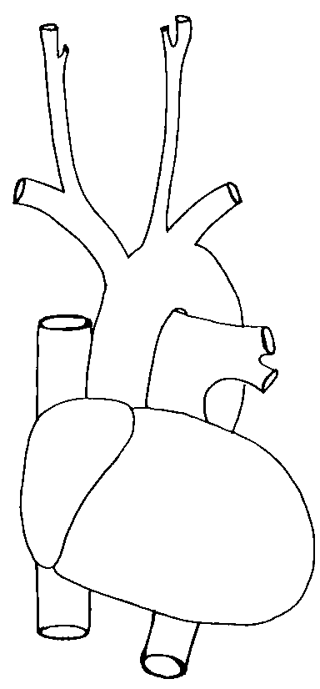
Respiratory reflexes
Sensory input from conscious area of the brain
Sensory input from other parts of the body
Sensory input from other parts of the body
Carbon dioxide and oxygen receptors
Respiratory centre
Nerve impulses to respiratory muscles

Slide 18
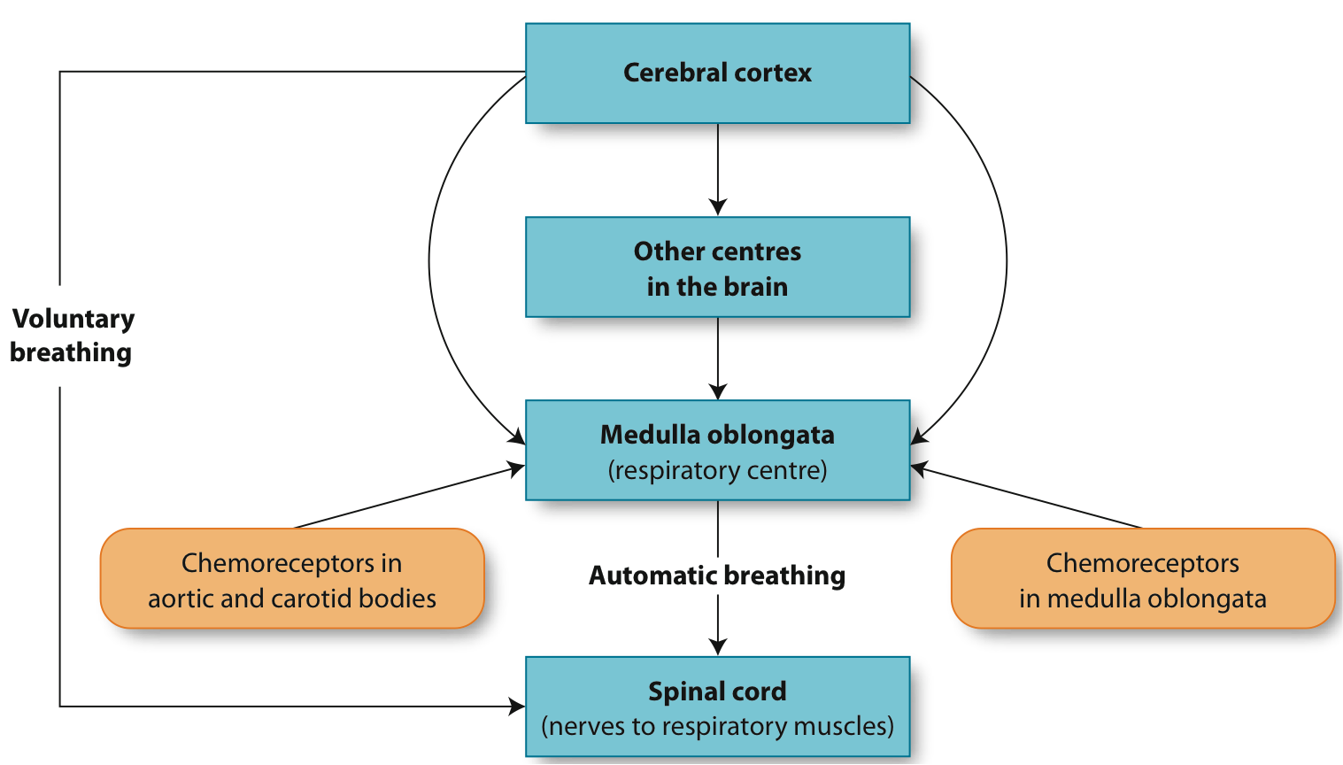
Control of breathing rate by the central nervous system

Slide 19
Oxygen Concentration
Oxygen plays only small part in regulation of breathing
The O₂ concentration must fall to very low levels below a normal for a major stimulatory effect to occur
Peripheral Chemoreceptors: Chemoreceptors called the aortic and carotid bodies are cells within the walls of the aorta and carotid arteries that are sensitive to changes in the concentration of oxygen in the blood plasma.
Central chemoreceptors in the medulla oblongata

Slide 20
Oxygen Concentration
A large decrease in oxygen concentration stimulates the chemoreceptors and nerve impulses are transmitted to the respiratory centre.
These nerve impulses stimulate the transmission of messages to the diaphragm and intercostal muscles so that the breathing rate increases.

Slide 21
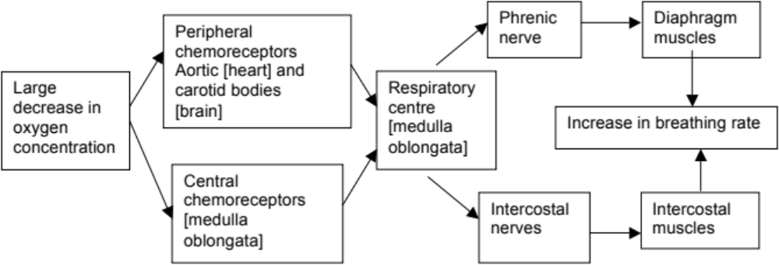
Oxygen Concentration

Slide 22
Carbon Dioxide Concentration
The concentration of carbon dioxide in the blood affects the concentration of hydrogen ions.
Carbon Water Carbonic Hydrogen Bicarbonate
Dioxide Acid ion ion

Slide 23
Carbon Dioxide Concentration
The concentration of carbon dioxide in the blood plasma is a major factor in the regulation of breathing rate.
A relatively small increase in the concentration of carbon dioxide (CO₂) causes a marked increase in the rate of breathing. The immediate increase occurs because of the stimulation of the aortic and carotid bodies.

Slide 24
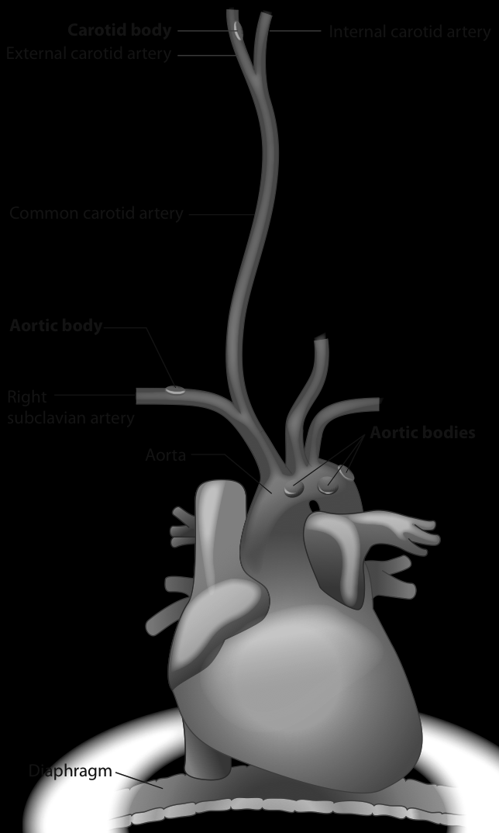
Location of aortic & carotid bodies

Slide 25
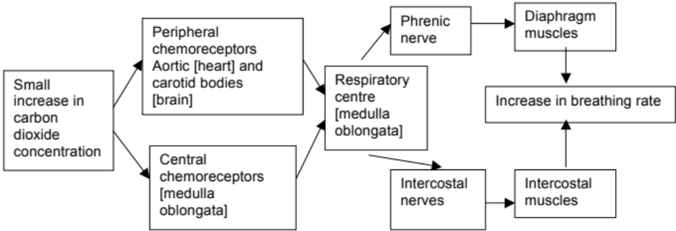
Carbon Dioxide Concentration

Slide 26
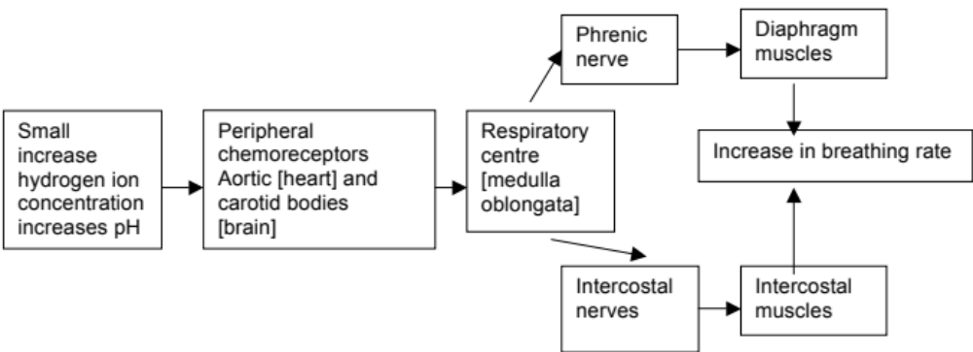
Hydrogen ion Concentration
Increasing hydrogen ions, decreases pH [increasing acidity] which directly stimulates the chemoreceptors in the aortic and carotid bodies

Slide 27
Effect of high CO₂/low O₂ on breathing
Stimulus - High CO₂ (= low pH or high H⁺) or low O₂
Receptor – Chemoreceptors
  Aorta - High CO₂ or low O₂
  Carotid artery – High CO₂ or low O₂
  Medulla oblongata - High CO₂ only
Control centre - Respiratory centres in brain stem
Transmission - Reflexes involving somatic nerves
Effector - Respiratory muscles
Response - Increased rate and depth of breathing

Slide 28
Negative feedback loop: Control of breathing rate through changes in the concentration of carbon dioxide & pH of blood plasma
Chemoreceptors
  Aorta
  Carotid artery
  Medulla oblongata
Decrease in breathing rate =
High CO₂
(= low pH or high H+)
or low O₂
Stimulus
Receptor
Negative feedback
Respiratory centres in brain stem
Decrease in levels of CO₂
& O₂ return to normal
Control
centre
Feedback
Reflexes involving somatic nerves
Response
Effector
Increased rate and depth of breathing
Increase in activity of Respiratory muscles

Slide 29
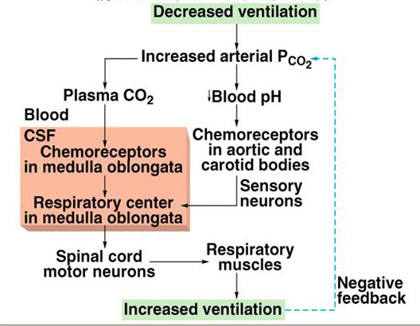

Slide 30
Control of breathing rate by the central nervous system
Voluntary Control of Breathing
By-passes Respiratory centre
Protective device: Prevents irritating gases & water entering lungs
e.g. holding your breath

Slide 31
Voluntary Control of Breathing
Hyperventilation
Rapid breathing that provides more oxygen (O₂) than required and removes more carbon dioxide (CO₂) than necessary.
Voluntarily or stress induced e.g. severe pain
Hyperventilation usually corrects itself because eventually the CO₂ levels return to normal.
Hyperventilating before swimming under water allows you to stay under water longer because of the loss of car (CO₂). The person could lose consciousness because of the lack of O₂ to the brain.

Slide 32
Effect of Exercise on breathing
Contracting muscle cells require large amounts of oxygen and produce large amounts of carbon dioxide.
In response, the respiratory centre increases the rate and depth of breathing.
During heavy exercise, the volume of air going in and out increases ten to twenty fold.

